Slide 1
Lecture 10 File-System Interface Manya Gidwani

Slide 2
File-System Interface
File Concept
Access Methods
Directory Structure
File-System Mounting
File Sharing
Protection

Slide 3
Objectives
To explain the function of file systems
To describe the interfaces to file systems
To discuss file-system design tradeoffs, including access methods, file sharing, file locking, and directory structures
To explore file-system protection

Slide 4
File Concept
Through the use of file a convenient environment is created that allows one to write , read, save & retrieve the program & data on any type of storage devices.
File concept is independent of data type
User or programmer need no wants to worry about the hardware complexity.
The information stored in files is in bits . Bytes, lines , record.
Normally files are stored in secondary memory.
The main concept of file are
File Management
File Allocation
File Access Methods

Slide 5
File Structure
The basic element of data, field, is a single valued item.
Ex: Name , Date , Emp _ID
It is characterized by its length & data type.
When multiple fields are combined to form Record.
When such similar records are collected , its called as File
File is treated as a single entity used by application or programmer
The OS must support a required structure for a certain type of file.

Slide 6
File Structure
Internal Structure & Record Blocking
Since the logical file will be mapped to the secondary storage, it is better to define the internal structure of the file in terms of the units of secondary storage.
The disk is used for secondary storage and hence, block is a unit taken for storage
The block unit need to be mapped to the logical file structure.

Slide 7
File Structure
Internal Structure & Record Blocking
Consider the logical record size as 1 byte.
A group of 512 byte is packed into one block of disk.
A file may be considered as a sequence of blocks.
All I/O operation is done in terms of blocks this is known as record blocking.
Larger the size of the block, more No. of records are mapped
Means large No. bytes will be transferred in one I/O operation

Slide 8
File Structure
Fixed Blocking:
Fixed size records are used
There may be a mismatch between the sizes of the record & block
Leaving some unused space in the last block: Internal Fragmentation

Slide 9
File Structure
Variable–length Spanned Blocking
Variable length record
Some records may span
Variable–length Unspanned Blocking
Records of variable size are used spanning is not considered in case of small size blocks.
A small size block is left unused
The records are allocated to a bigger block

Slide 10
File Name & File Type
There are rule for naming the file, which vary from system to system.
Some system distinguish between uppercase & Lowercase.
The length of the file name is as long as 255 character
The file name has two parts:
Name of the file
extension

Slide 11
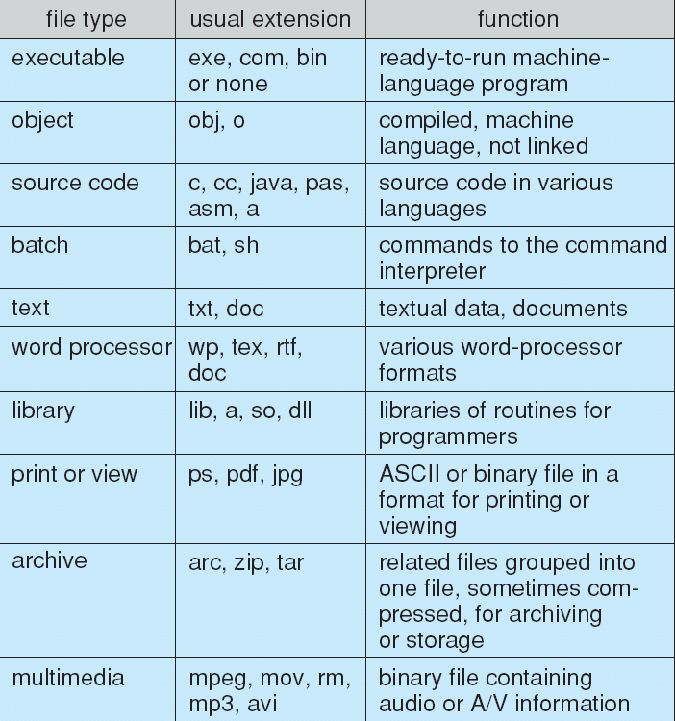
File Name & File Type

Slide 12
File Attributes
Name – only information kept in human- readable form
Identifier – unique tag (number) identifies file within file system
Type – needed for systems that support different types
Location – pointer to file location on device
Size – current file size
Protection – controls who can do reading, writing, executing
Time, date, and user identification – data for protection, security, and usage monitoring
Information about files are kept in the directory structure,
which is maintained on the disk

Slide 13
File Operations
File is an abstract data type
Create
Write
Read
Reposition within file
Delete
Truncate
Open – search the directory structure on disk for entry , and move the content of entry to memory
Close – move the content of entry in memory to directory structure on disk

Slide 14
Open Files
Several pieces of data are needed to manage open files:
File pointer: pointer to last read/write location, per process that has the file open
File-open count: counter of number of times a file is open – to allow removal of data from open-file table when last processes closes it
Disk location of the file: cache of data access information
Access rights: per-process access mode information

Slide 15
Implementation of File Operations
Open File Table:
keep the record of opened files on process basis
no need to search in the directory every time
Stores the attributes of opened file
The count increment for open() call and decrement for close() call
count=0 , file is no longer in use.
System-wide Open File Table:
Maintain the status of the file on system basis
Process independent information about the file is maintained like location of the file, file size etc,.
Address of the File on Disk:
Where it resides in the disk, needed every time the file is opened
To avoid reading the address from the disk again & again.
Its address is kept in the memory.

Slide 16
Access Methods
Sequential Access
Simplest access method
Information in the file is processed in order, one record after another
a read operation reads the next portion of the file & automatically advances the file pointer.
A write appends to the end of the file & advances to the end of the newly written material
Based on the Tape model of a file.

Slide 17
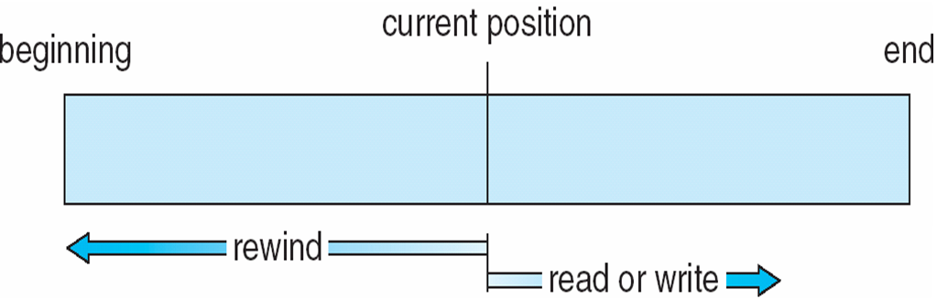
Sequential-access File

Slide 18
Access Methods
Direct Access Or Relative access
A file is made of fixed length logical record
Based on the disk model of the file
The file is viewed as a numbered sequence of blocks or records
Allows random blocks to be read or write.
There are no restriction to the reading & writing for a direct access file.

Slide 19
Access Methods
Indexed Access
The index contains pointers to various blocks
To find the entry in the file, we first search the index, and then use the pointer to access the file directly and to find the desired entry.
The time to search a record is greatly reduced.

Slide 20
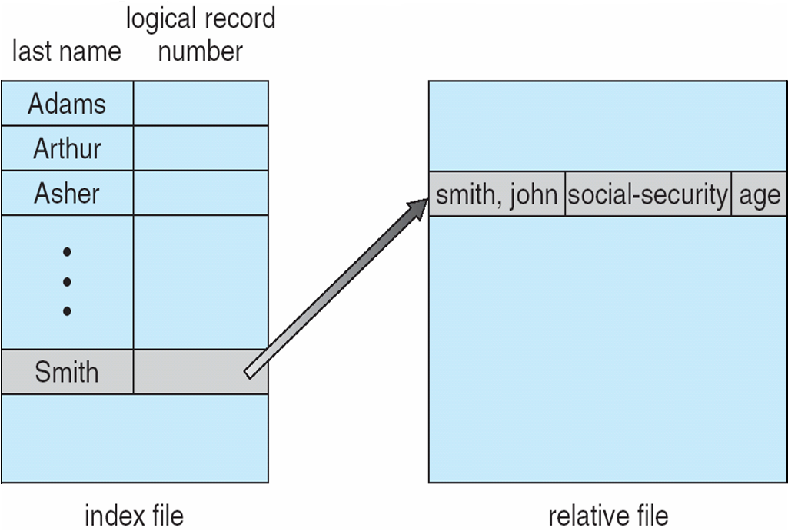
Example of Index and Relative Files

Slide 21
Thank U

